Slide 1
RTI Toolkit Chapter 4
Interventions: How to Select, Package, and Use Them

Slide 2
Interventions
Specific strategies adopted to help students make progress toward academic or behavioral goals
Foundation of RTI- Interventions drive the entire process

Slide 3
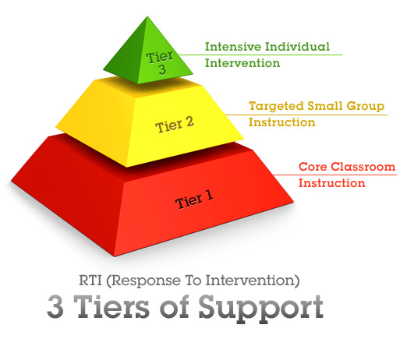
3 Levels of Intervention

Slide 4
Steps to a Successful Intervention
Identify underlying reason for poor school performance
Find 1 or more research-based strategies matching student need
Organize strategy into a plan that is teacher friendly
Assess intensity of intervention plan
Select at least 1 method to measure quality of teacher’s intervention

Slide 5
1. Identify underlying reason for poor school performance
Complete School Work Motivation Assessment
Academic motivation= reasonable expectation of success AND significant value on achieving success (Exhibit 4-A)
Analyze student academic skills
Instructional Hierarchy- 4 predictable stages of learning (Exhibit 4-B)
Acquisition- has begun to learn how to complete skill
Fluency- able to complete skill accurately but slowly
Generalization- cannot use skill in different situations
Adaptation- cannot adapt or modify skill to fit a new demand
Define academic problems in detail (Exhibits 4-C & 4-D)
Helps find the most effective strategy
Notes:
Exhibit 4-A: Example: Give time challenging work without and with a reinforcer. Score. If score is 20% better when offered reinforcer, it suggests poor motivation and intervention plan should include strategies to boost motivation

Slide 6
2. Find 1 or more research-based strategies matching student need
Research-based: high probability of being effective
We want to avoid potential danger of choosing the wrong approach as it could worsen the problem

Slide 7
3. Organize strategy into a plan that is teacher friendly
Clear instructions
Should be able to be carried out by anyone
Plan should include (Exhibit 4-E):
Step-by-step script
List of the people responsible for carrying out plan
Information on preparing and putting intervention into practice
Citation of 1 or more research-based sources that support intervention

Slide 8
4. Assess intensity of intervention plan
Important to find what works for the student (Exhibit 4-F)
Customized Plans
Unique to students needs
Classroom-based/Teacher responsible
Drawback= teacher has limited time to deliver individual interventions
“Standard Protocol” Plans
Pull out program
Greater potential to improve behavior/skill more rapidly
Drawback=Requires extra resources, does not give answer to what accommodations the child needs to be successful in general education

Slide 9
5. Measure quality of teacher’s intervention
Many obstacles to success:
Lack of materials, skills, training
Failure to perform steps correctly
“Intervention follow-through”- how well an intervention is carried out
Measured through…
an observer (most objective, most time intensive)- Exhibit 4-E
Self-monitor checklist (subjective, evaluated more frequently)- Exhibit 4-E
Evaluation Log (quick, convenient, subjective, least preferred method)- Exhibit 4-G
Notes:
Good follow through means: follow all steps on script, use frequently, and as long as planned

Slide 10
Intervention Bank
Place for common referral concerns
Appendix A
Organized in table(Handout)
Intervention Central (Handout)

