Slide 1
Project Based Learning
Diocese of Rochester Teacher Conference
October 9, 2015
Margaret Henry

Slide 2
Welcome! Thank you for choosing this session!
Presentation norms
Be present
Be collaborative
Be respectful
Signal
Music!

Slide 3
Imagine life as problem free.
How wonderful would it be? Or would it?
Notes:
Discuss with someone near you what your morning would have been like if your life was problem free. Then discuss if you think a problem free life would be wonderful.

Slide 4
Notes:
In any case, life does not come problem-free because that is the nature of life here on earth, full of challenging opportunities to learn, grow, reflect, and enjoy.
This may be the most obvious reason why project-based learning is important for us to consider – PBL engages students in life as we know it, full of fascinating, problematic situations worth thinking about, investigating, and resolving.

Slide 5
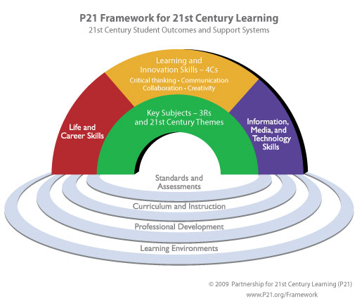
What is Project Based Learning?
Project based learning is a student or group of students using the 21st century skills of problem solving, critical thinking, communicating, and collaborating to create an information, media, or technology based presentation from a challenging question that expands their key subject knowledge to come to logical conclusions, which will provide skills to aid them in their life and career.
“Framework for 21st Century Learning …illustrate the skills and knowledge students need to succeed in work, life and citizenship, as well as the support systems necessary for 21st century learning outcomes.” (www.p21.org)
Notes:
As teachers it is our job to prepare students for work and life. The 21st Century Learning Framework was developed by teachers, education experts, and business leaders to aligns the skills, knowledge, and expertise students must master in their work and life. The pool at the bottom represents the support systems to create the student outcomes represented by the arches of rainbow. The support systems are standards, assessments, curriculum, instruction, professional development, and learning environments. The student outcomes are life ancareer skills, learning and innovation skills including the 4 Cs, Information media and technology skills, and the key subjects including reading writing, and arithmetic. Project Based Learning fits into this framework as a form of instruction that provides the student outcomes.

Slide 6
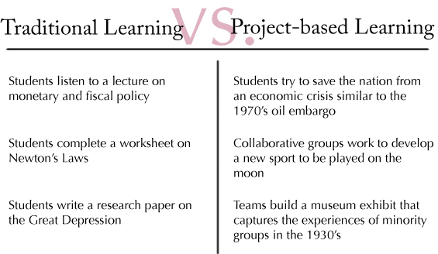
It is NOT.
Notes:
Traditional learning lacks the learning and innovation skills necessary to meet the student outcomes of 21st Century Learning, which includes critical thinking (not allowing a teacher to think for you), communication, collaboration, and creativity.

Slide 7
It is NOT.
Notes:
Now you may be saying well I don’t just lecture, I do hands-on learning with my students and have them create a visual, a song, a PowerPoint, or write a play. This all falls under “Doing Projects.” “Doing Projects” also lacks the learning and innovation skills necessary to meet the student outcomes of 21st Century Learning, which again includes critical thinking (not allowing a teacher to think for you), communication, collaboration, and creativity. This is the reason I prefer to refer to it as Problem Based Learning. Projects do not always require the 4Cs, however when the child starts off with a problem and develops a solution, the 21st Century Learning Skills are in place. The focus is more on the process when it is referred to a problem than the product when it is called Project Based Learning.

Slide 8
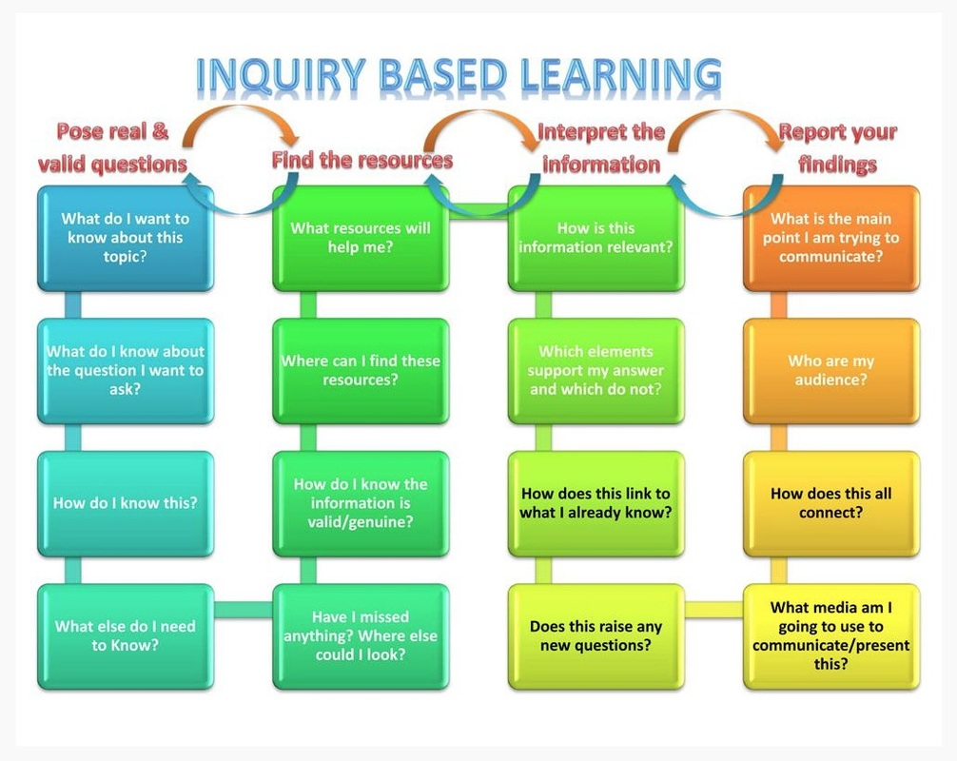
It is NOT.
Notes:
Inquiry Based Learning is when you allow the student to come up with a question, research it, interpret the information, and produce the product without the structure from the teacher.

Slide 9
So what is it exactly?
Notes:
Project Based Learning is more structured. You may feel that Inquiry based is too far out of your comfort zone where there is not a lot of control. Well PBL is more structured and guided by the teacher but is centered on the student. It has 7 components. 1. Need to Know 2. A Driving Question or Challenge 3. Student Voice and Choice 4. 21st Century Skills 5. Inquiry and Innovation 6. Feedback and Revision 7. A Publicly Presented Product. This puts

Slide 10
PBL projects …
are central to the curriculum
are focused on problems that "drive" students to encounter the central concepts of a discipline
involve students in a constructive investigation
are student-driven
are realistic, not school-like
(Thomas, 2000)
Notes:
Project Based Learning are central, not peripheral to the curriculum. It can include ELA, Math, Science, Social Studies, and even Religion. It is focused on problems or questions that drive student to encounter and struggle with the central concepts and principles of a discipline. It involves students in a real world investigation they construct, which leads to the student driven component to a degree. As teachers we are facilitators and still can guide their thinking. This is a component you can control depending on how comfortable you are with the concept, as well as, the level of the students. You can guide questioning about a topic to lead to the driving question or you can discuss research with a more positive referral toward one topic than another. If you are willing to give over more control you can allow them to come up to a conclusions on their own without guidance.

Slide 11
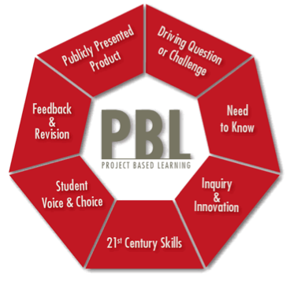
1. Need to Know
Students learning about a world problem.
An entry event:
A video
A lively discussion
A guest speaker
A field trip
Mock correspondence
Notes:
Instead of standing up in front of the class and making the statement of what the students will be learning and doing,
teachers can activate a students need to know content powerfully by setting up an entry event. An entry event engages the students’ interest and initiates the questioning. An entry event can be almost anything.

Slide 12
2. A Driving Question
The center of PBL: gives students the purpose and challenge
Teachers can lead the brainstorming of solutions
Questions= provocative, open-ended, complex, linked to intended content
Abstract, Concrete, or Solving a Problem
Examples: creating a law, awareness, invention, designing
Notes:
The Driving Question is the center or heart of the PBL. It will direct the students to solve the problem addressed in the entry event. This question gives the students the purpose and challenge. The teacher can help lead a discussion after the entry event guiding them to create a provocative, open-ended, complex question that is linked to your intended content. The question can be abstract, concrete, or a question to solve a problem. Such questions could include how to create awareness of a problem, or how to design a process or object to solve a problem.

Slide 13
3. Student Voice and Choice
Choose topic within driving question
Choose design, creation, and presentation
Choose resources to use
Notes:
This element is key in PBL. The students can choose their topic within the driving question, how they will design, create, and present their product, and how they use their resources. This choice and voice can be guided by the teacher in order for it to not become too overwhelming for the students. Teachers can provide a list of options to choose from and the student can choose.

Slide 14
4. 21st Century Skills
Collaboration
Communication
Critical Thinking
Technology
Notes:
PBL should provide opportunities to develop the students 21st century skills, including collaboration, communication, critical thinking, and the use of technology. Teachers teaches these skills and assesses them along with students assess themselves.

Slide 15
5. Inquiry and Innovation
Real questions
Searching resources
Discovering answers
New questions
Testing ideas
Drawing own conclusions
Notes:
Learning is more meaningful if students conduct real inquiry. This does not include finding information in books or websites and regurgitating it on a poster or PowerPoint. Real inquiry is their own questions that lead to searching resources, discovering answers, generating new questions, testing ideas, and drawing own conclusions. Real inquiry brings innovation.

Slide 16
6. Feedback and Revision
Revision is a part of real world work.
Coaching- by teacher, by peers, by experts
Notes:
Students learn that feedback and revision are a part of real world work that they will encounter in their future. The writing of books require constant rewriting after feedback from their editors. Teachers can coach students to coach each others using rubrics and criteria or bring in experts to help coach skills.

Slide 17
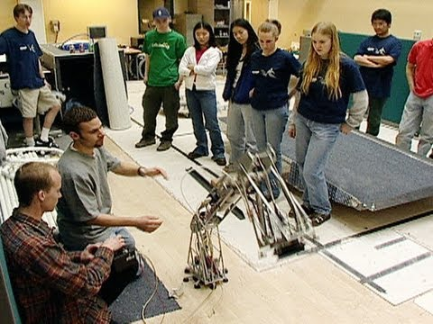
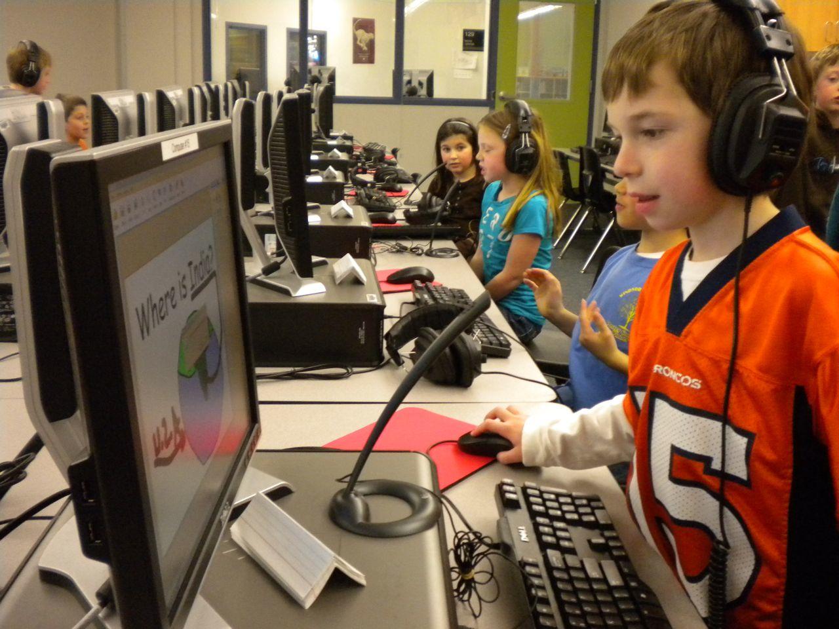
7. A Publicly Presented Product
Not a product for the teacher or test
A real product enhances quality
Notes:
Their work is more meaningful if it’s not for the teacher. The skills we teach our students is not to please us as teachers, its for them and their future. Through a real product they can feel the real meaning behind their work. When there is true meaning behind their work the quality of the work will also enhance the quality of the work.

Slide 18
Teacher’s Role
Facilitator for the students through the process
Scaffolding strategies for problem solving and critical thinking
Structure the process
Work with students to create worthwhile questions and set goals
Give constructive feedback to students through the process
Research possible experts or resources to bring into the classroom

Slide 19
Student’s Role
Create a challenging question.
Collaborate with peers
Use 21st century skills to research the answer
Record information, experiment, and record data.
Create a product of information found
Stay accountable to self, peers, and teacher

Slide 20
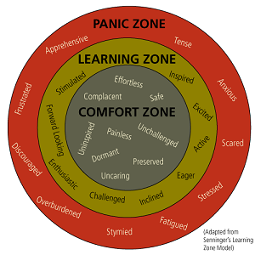
Possible Challenges
initiating inquiry
directing research/investigation
managing time
using technology productively

Slide 21
Benefits of Project Based Learning
Increases student motivation and engagement
Student-initiated learning
Improves student retention
Increases academic achievement
21st century skills
Effective with lower-achieving students
Differentiation
Notes:
Research from the Buck Institute states the following benefits…1. Increases student motivation and engagement in learning 2. it is student-initiated, which will improve the student retention of knowledge over time because they are able to have a say in what he/she is learning. 3. It is more effective than traditional instruction in increasing academic achievement due to the fact that they are motivated and retaining the information. 4. It improves the mastery of 21st century skills 5. It is especially effective with lower-achieving students which leads into it being a beneficial way of instruction when differentiating because students will not be cookie cutter in reading the same information and producing the same result. Instead a student can find information at his/her level and produce work at his/her level.

Slide 22
Current PBL students
Notes:
As you may have noticed I started the presentation today with an entry event (asking what life would be like problem free) and I enacted a driving question (What is PBL?)…now it is time for Student Voice & Choice…

Slide 23
Get out your Project Design Template

Slide 24
Power Standard (pg. 1)
What is the main standard or standards you want to focus on?
Identify the learning targets and evidence of success

Slide 25
Performance Objectives (pg. 2)
What do you want the students to know and be able to do?
Notes:
We all know the standard terms but in more specific terms related to your topic, what are your students going to walk away with?

Slide 26
Here comes your collaboration and student voice!
Discuss in a group of like minded subject areas
what power standards you would like to address
what that means for your performance objectives

Slide 27
Driving Question (pg. 2)
What type of question will drive your students to learning these topics?
Notes:
We all know the standard terms but in more specific terms related to your topic, what are your students going to walk away with?

Slide 28
Project Idea (pg. 1)
What type of project could get my students to meet these standards by being driven by this question?

Slide 29
Resources (pg. 3)
What resources do you have around you or available online?
Companies
People
Parks
Places
Online

Slide 30
Entry Event (pg. 1)
What type of video, discussion, guest speaker, pictures, field trip, or mock correspondence could get my students to create the driving question?

Slide 31
Here comes some more student choice and collaboration with critical thinking!
Discuss in your group:
The Driving Question
The Project Idea
Resources (Bing it! or Google it!)
The Entry Event

Slide 32
21st Century Skills (pg. 1)
What 21st Century Skills will they need to use during this project?
Handout
Microsoft Educator Network:
http://pilnetwork.blob.core.windows.net/public/21CLD%20Learning%20Activity%20Rubrics%202012.pdf

Slide 33
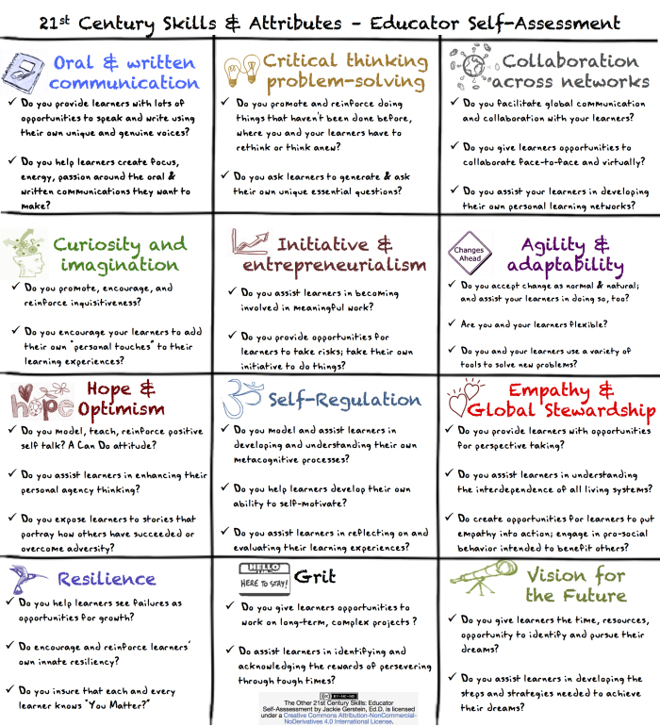
Here comes some communication and vision for the future!
Discuss in your group:
21st Century Skills that could be incorporated

Slide 34
Assessment Plan(pg. 2)
What will you expect the students to produce in a group?
What will you expect the students to produce individually?
Notes:
We all know the standard terms but in more specific terms related to your topic, what are your students going to walk away with?

Slide 35
Product Evaluation (pg. 3)
What knowledge & skills do they need for this product?
Will they have this prior to the Project or will they be taught this?

Slide 36
Assessment & Reflection (pg. 3)
How will other content & skills be assessed?

Slide 37
More collaboration!
Discuss in your group:
Assessment Plan
Product Evaluation
Assessment & Reflection

Slide 38
Project Evaluation
A project is not done until it has been reflected upon.

Slide 39
Manage the Process

Slide 40
Last collaboration!
Discuss as a group:
Project Evaluation
Manage Process

Slide 41
Resources
bie.org
http://www.learningreviews.com/Project-Based-Learning-Lesson-Plans.html
http://www.innovationunit.org
http://www.edutopia.org/project-learning
https://21centuryedtech.wordpress.com/2013/09/15/the-pbl-super-highway-over-45-links-to-great-project-based-learning/
http://www.trumbullesc.org/projectproblembasedlearning.aspx
Notes:
Now that you did all that work, here are some sources to find already made PBL lesson plans. Bie.org explains project based learning including videos.

Slide 42
Teachers of PBL
Notes:
Now you have the tools and a PBL unit to enact PBL in your own classroom. Good Luck and Have fun!

Slide 43
Resources
bie.org
Thomas, J. (2000). A review of research for project-based learning. (http://www.bie.org/index.php/site/RE/pbl_research/29)
Notes:
Bie.org explains project based learning including videos.

